Slide 1

Problem Statement : Case Study 1
Vehicle Accident Damage Analysis
HackArena'17
CONFIDENTIAL
October 2017

Slide 2
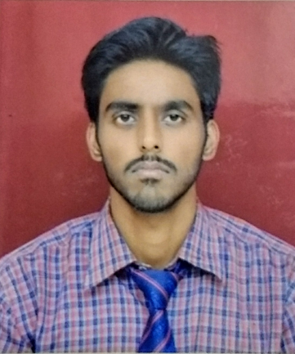
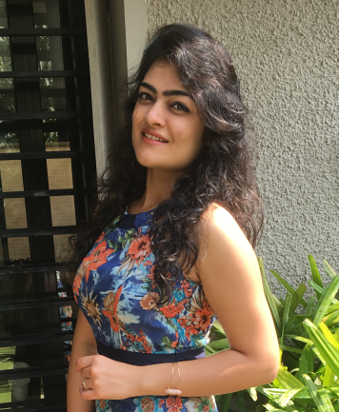
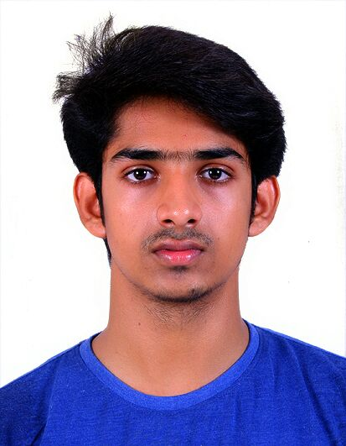
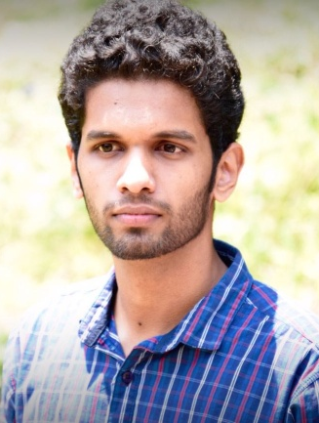
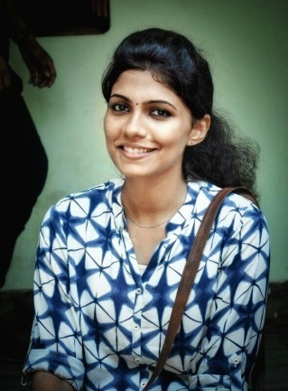
THE BRAINS
Akash Srivastav
Saloni Juneja
Kevin Toms
Bobin Shaji
Anju Mons
(TEAM 67)

Slide 3
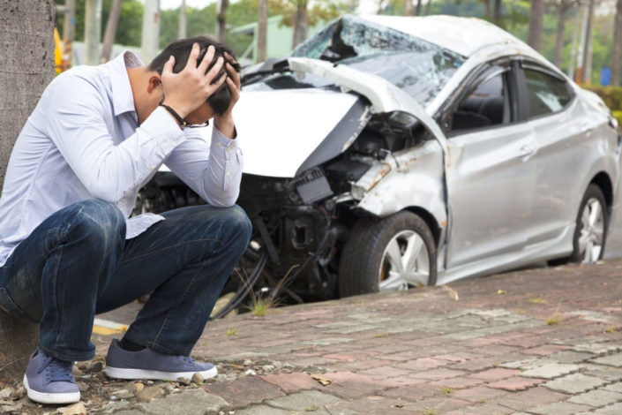
INTRODUCTION
Being in a car accident is unfortunate, and to have to go through the insurance claim process is even more. What if there was a system that could simplify this hectic process?
This is where the proposed model comes in the picture. It is an effort to digitize the complete claims triage through the means of analyzing the vehicle’s damage from pictures through machine learning.

Slide 4
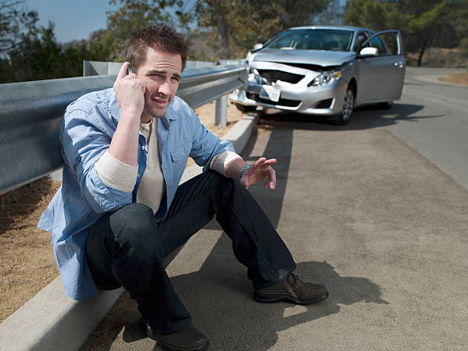
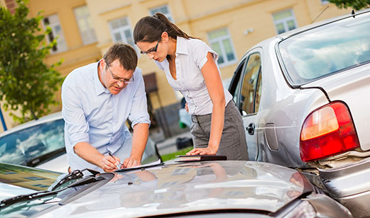
CURRENT SCENARIO
Highly taxing and time taking process of reimbursement
Dependence on the loss assessor for the cost estimation
It takes about 3-4 weeks for claim amount to be processed

Slide 5
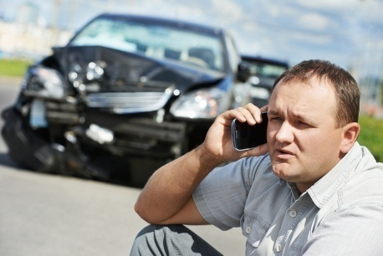
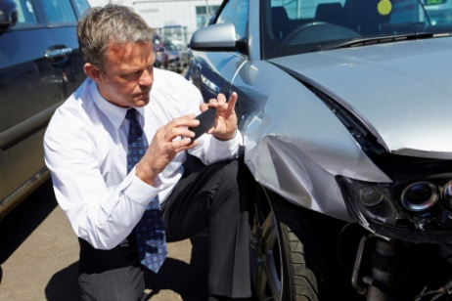
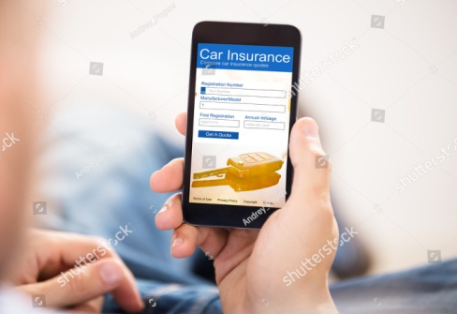

SOLUTION DESCRIPTION
Fill online claim form
Upload pictures of the accidental car
Take the car to the workshop
Wait for reimbursement

Slide 6
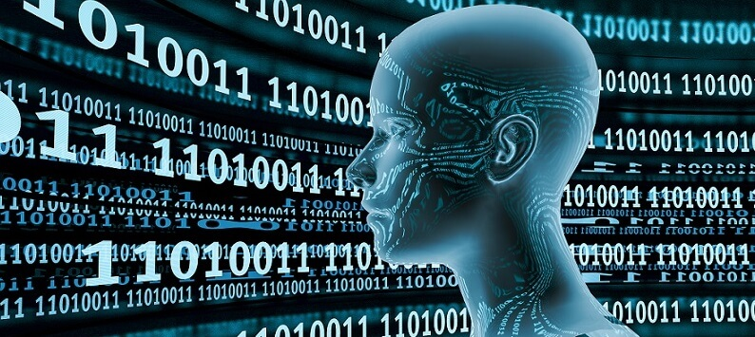

NOVELTY FACTOR
The use of machine learning to process the image and provide a cost estimate
Eliminating the need for a physical survey
Comfort of home
Quick online reimbursement
Identifying perils: Cause of accident

Slide 7
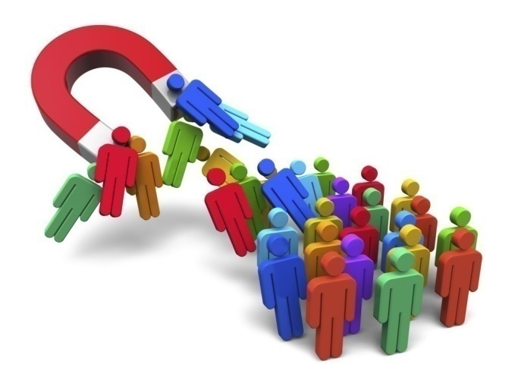

BUSINESS IMPACT
Reduction in time to obtain the claim amount
Elimination of the intermediary person
This solution will attract more customers
Increase the business for the insurance company that deploys this model

Slide 8
SWOT ANALYSIS
STRENGTH 1. Always learning from experience 2. Very high rate of accuracy 3. Continuous availability 4. Customers can apply for claims from the comfort of their homes | WEAKNESS 1. Computing power and time required to train the model is very high 2. Huge amount of data sets required to account for variations
OPPORTUNITY 1. Completely new approach to a prevalent problem 2. Room for improvement is huge | THREAT 1. People might want to get more remuneration by uploading pictures of different cars with similar or more damage 2. Photographs of better quality and good lighting difficult to obtain at night

Slide 9
Thank You

